Slide 1

Intro to Spark & Zeppelin
Robert Hryniewicz
Data Evangelist
@RobHryniewicz

Slide 2
Apache Spark Background

Slide 3
What is Spark?
Apache Open Source Project - originally developed at AMPLab (University of California Berkeley)
Data Processing Engine - focused on in-memory distributed computing use-cases
API - Scala, Python, Java and R

Slide 4
Spark Ecosystem
Spark SQL
Spark Streaming
MLLib
GraphX
Spark Core

Slide 5
Why Spark?
Elegant Developer APIs
Single environment for data munging and Machine Learning (ML)
In-memory computation model – Fast!
Effective for iterative computations and ML
Machine Learning
Implementation of distributed ML algorithms
Pipeline API (Spark ML)

Slide 6
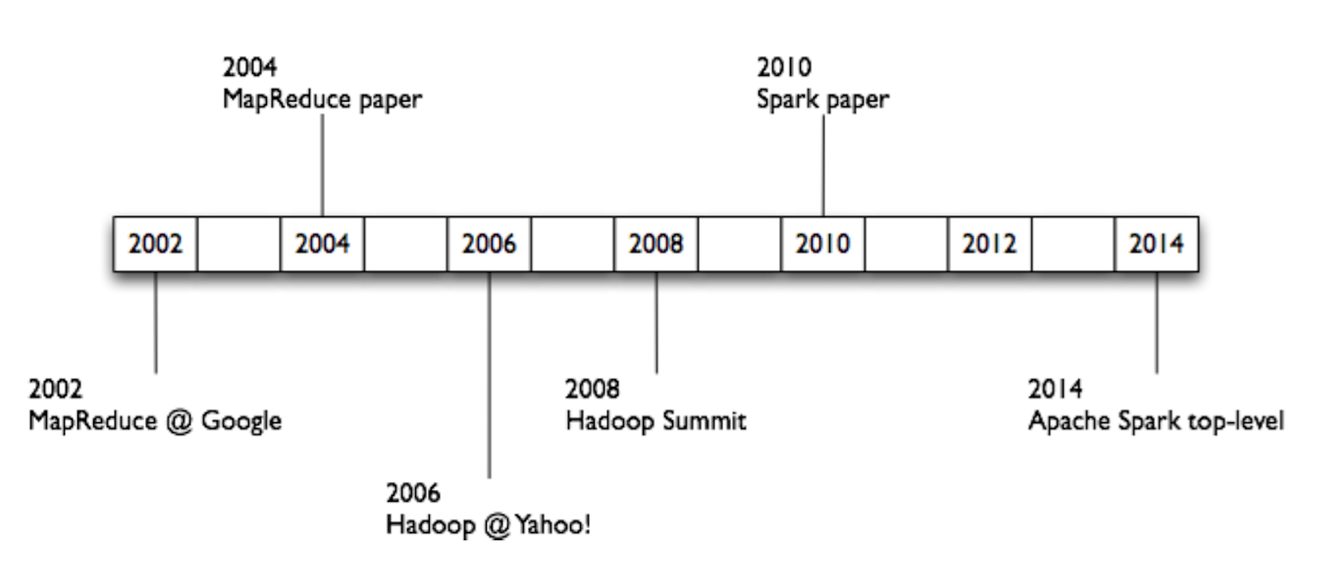
History of Hadoop & Spark

Slide 7
Apache Spark Basics

Slide 8
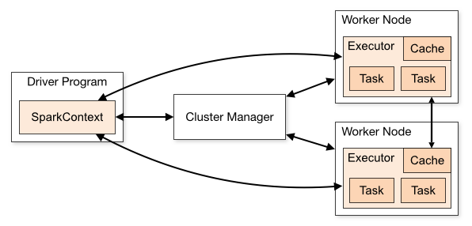
Spark Context
What is it?
Main entry point for Spark functionality
Represents a connection to a Spark cluster
Represented as sc in your code

Slide 9
RDD - Resilient Distributed Dataset
Primary abstraction in Spark
An Immutable collection of objects (or records, or elements) that can be operated on in parallel
Distributed
Collection of elements partitioned across nodes in a cluster
Each RDD is composed of one or more partitions
User can control the number of partitions
More partitions => more parallelism
Resilient
Recover from node failures
An RDD keeps its lineage information -> it can be recreated from parent RDDs
Created by starting with a file in Hadoop Distributed File System (HDFS) or an existing collection in the driver program
May be persisted in memory for efficient reuse across parallel operations (caching)

Slide 10
RDD – Resilient Distributed Dataset
RDD 1
Partition 1
Partition 2
Partition 3
Partition 4
Cluster
Nodes
RDD 2
Partition 1
Partition 2
Partition 3

Slide 11
Spark SQL

Slide 12
Spark SQL Overview
Spark module for structured data processing (e.g. DB tables, JSON files)
Three ways to manipulate data:
DataFrames API
SQL queries
Datasets API
Same execution engine for all three
Spark SQL interfaces provide more information about both structure and computation being performed than basic Spark RDD API

Slide 13
DataFrames
Conceptually equivalent to a table in relational DB or data frame in R/Python
API available in Scala, Java, Python, and R
Richer optimizations (significantly faster than RDDs)
Distributed collection of data organized into named columns
Underneath is an RDD

Slide 14
DataFrames
Text
Avro
CSV
Column
Created from Various Sources
DataFrames from HIVE:
Reading and writing HIVE tables, including ORC
DataFrames from files:
Built-in: JSON, JDBC, ORC, Parquet, HDFS
External plug-in: CSV, HBASE, Avro
DataFrames from existing RDDs
with toDF()function
Col1 | Col2 | … | … | ColN
Spark SQL
Row
DataFrame
(with RDD underneath)
HIVE
Data is described as a DataFrame with rows, columns and a schema

Slide 15
SQL Context and Hive Context
SQLContext
Entry point into all functionality in Spark SQL
All you need is SparkContext
val sqlContext = SQLContext(sc)
Use when your data resides in Hive
HiveContext
Superset of functionality provided by basic SQLContext
Read data from Hive tables
Access to Hive Functions → UDFs
val hc = HiveContext(sc)

Slide 16
Spark SQL Examples

Slide 17
DataFrame Example
Reading Data From Table
val df = sqlContext.table("flightsTbl")
df.select("Origin", "Dest", "DepDelay").show(5)
+------+----+--------+
|Origin|Dest|DepDelay|
+------+----+--------+
| IAD| TPA| 8|
| IAD| TPA| 19|
| IND| BWI| 8|
| IND| BWI| -4|
| IND| BWI| 34|
+------+----+--------+

Slide 18
DataFrame Example
Using DataFrame API to Filter Data (show delays more than 15 min)
df.select("Origin", "Dest", "DepDelay”).filter($"DepDelay" > 15).show(5)
+------+----+--------+
|Origin|Dest|DepDelay|
+------+----+--------+
| IAD| TPA| 19|
| IND| BWI| 34|
| IND| JAX| 25|
| IND| LAS| 67|
| IND| MCO| 94|
+------+----+--------+

Slide 19
SQL Example
Using SQL to Query and Filter Data (again, show delays more than 15 min)
// Register Temporary Table
df.registerTempTable("flights")
// Use SQL to Query Dataset
sqlContext.sql("SELECT Origin, Dest, DepDelay FROM flights WHERE DepDelay > 15 LIMIT 5").show
+------+----+--------+
|Origin|Dest|DepDelay|
+------+----+--------+
| IAD| TPA| 19|
| IND| BWI| 34|
| IND| JAX| 25|
| IND| LAS| 67|
| IND| MCO| 94|
+------+----+--------+

Slide 20
RDD vs. DataFrame

Slide 21
RDDs vs. DataFrames
RDD
Lower-level API (more control)
Lots of existing code & users
Compile-time type-safety
DataFrame
Higher-level API (faster development)
Faster sorting, hashing, and serialization
More opportunities for automatic optimization
Lower memory pressure

Slide 22
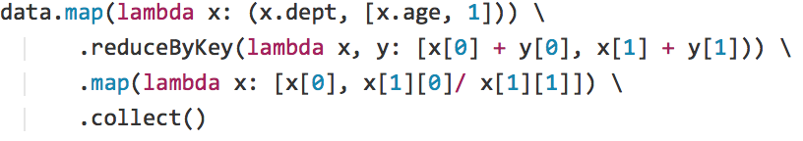
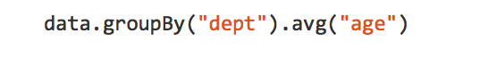
Data Frames are Intuitive
Find average age by department?
RDD Example
dept | name | age
Bio | H Smith | 48
CS | A Turing | 54
Bio | B Jones | 43
Phys | E Witten | 61
Equivalent Data Frame Example

Slide 23
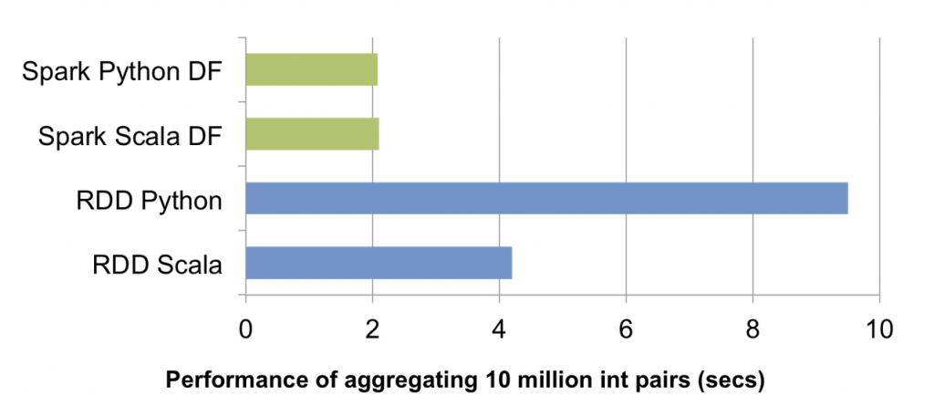
Spark SQL Optimizations
Spark SQL uses an underlying optimization engine (Catalyst)
Catalyst can perform intelligent optimization since it understands the schema
Spark SQL does not materialize all the columns (as with RDD) only what’s needed

Slide 24
Apache Zeppelin & HDP Sandbox

Slide 25
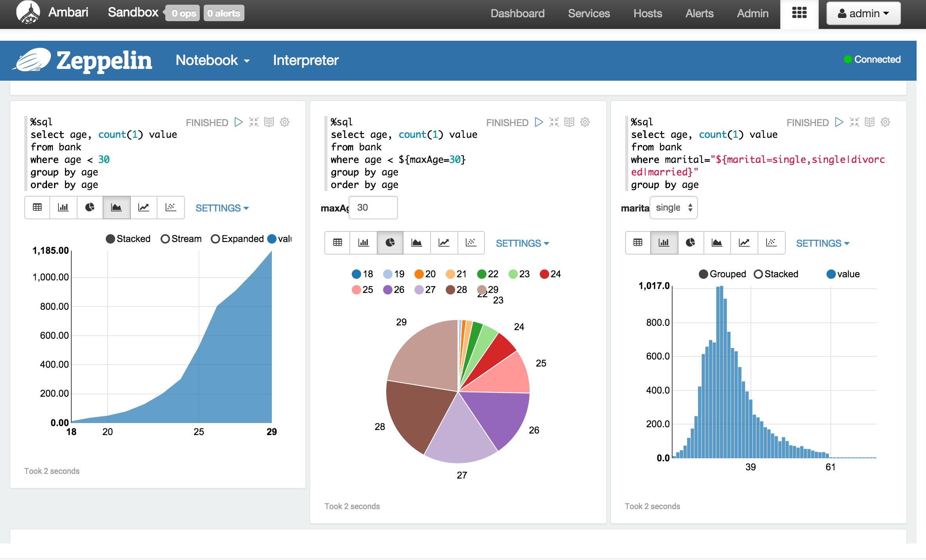
Apache Zeppelin
Web-based Notebook for interactive analytics
Use Cases
Data exploration and discovery
Visualization
Interactive snippet-at-a-time experience
“Modern Data Science Studio”
Features
Deeply integrated with Spark and Hadoop
Supports multiple language backends
Pluggable “Interpreters”

Slide 26

What’s not included with Spark?
Applications
Scala Java Python libraries
MLlib (Machine learning)
Spark
SQL*
Spark Streaming*
Spark Core Engine
Spark Core Engine
Resource Management
Storage

Slide 27
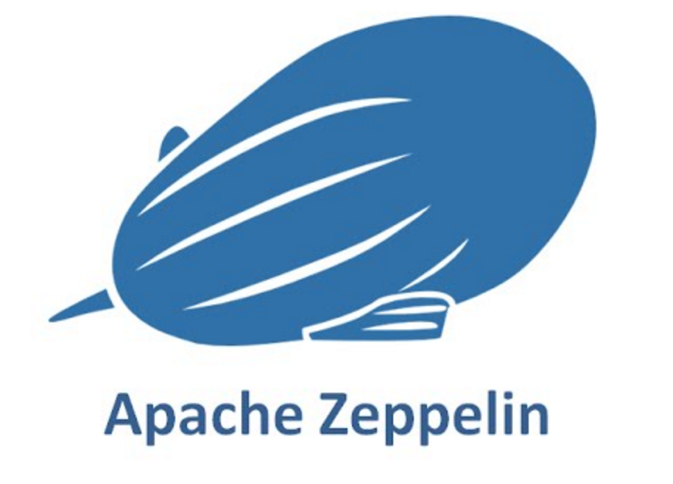
HDP Sandbox
What’s included in the Sandbox?
Zeppelin
Latest Hortonworks Data Platform (HDP)
Spark
YARN → Resource Management
HDFS → Distributed Storage Layer
And many more components...
Scala Java Python
R APIs
MLlib
Spark
SQL
Spark Streaming
GraphX
Spark Core Engine
YARN
HDFS
1
°
°
°
°
°
°
°
°
°
°
°
°
°
°
°
°
°
°
°
°
N

Slide 28
Access patterns enabled by YARN
Applications
Batch Needs to happen but, no timeframe limitations
Interactive Needs to happen at Human time
Real-Time Needs to happen at Machine Execution time.
Batch
Interactive
Real-Time
YARN: Data Operating System
HDFS Hadoop Distributed File System
1
°
°
°
°
°
°
°
°
°
°
°
°
°
°
°
°
°
°
°
N
°

Slide 29
Why Spark on YARN?
Utilize existing HDP cluster infrastructure
Resource management
share Spark workloads with other workloads like PIG, HIVE, etc.
Scheduling and queues
YARN container
Client
Spark
Application Master
Spark Driver
Spark Executor
Spark Executor
Spark Executor
Task
Task
Task
Task
Task
Task
YARN container
YARN container
YARN container

Slide 30
Why HDFS?
Fault Tolerant Distributed Storage
Divide files into big blocks and distribute 3 copies randomly across the cluster
Processing Data Locality
Not Just storage but computation
1
Cluster
101101001010010011100111111001010011101001010010110010010101001100010100101110101110101111011011010101101001010100101010101011100100110101110100
1
3
2
2
4
1
3
Blocks
3
2
4
4
2
3
4
1
Logical File

Slide 31
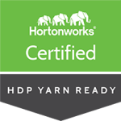
There’s more to HDP
DATA ACCESS
GOVERNANCE & INTEGRATION
SECURITY
OPERATIONS
Hortonworks Data Platform 2.4.x
DATA MANAGEMENT
Data Lifecycle & Governance
Falcon
Atlas
Batch
MapReduce
Script
Pig
SQL
Hive
NoSQL
HBase
Accumulo
Phoenix
Stream
Storm
Search
Solr
In-memory
Others
ISV Engines
Administration
Authentication
Authorization
Auditing
Data Protection
Ranger
Knox
Atlas
HDFS Encryption
Provisioning, Managing, & Monitoring
Ambari
Cloudbreak
Zookeeper
Tez
Tez
Slider
Slider
YARN : Data Operating System
Data Workflow
Sqoop
Flume
Kafka
NFS
WebHDFS
HDFS Hadoop Distributed File System
1
°
°
°
°
°
°
°
°
°
°
Scheduling
Oozie
°
°
°
°
°
°
°
°
°
°
N
Deployment Choice
Linux
Windows
On-Premise
Cloud

Slide 32
Hortonworks Community Connection

Slide 33
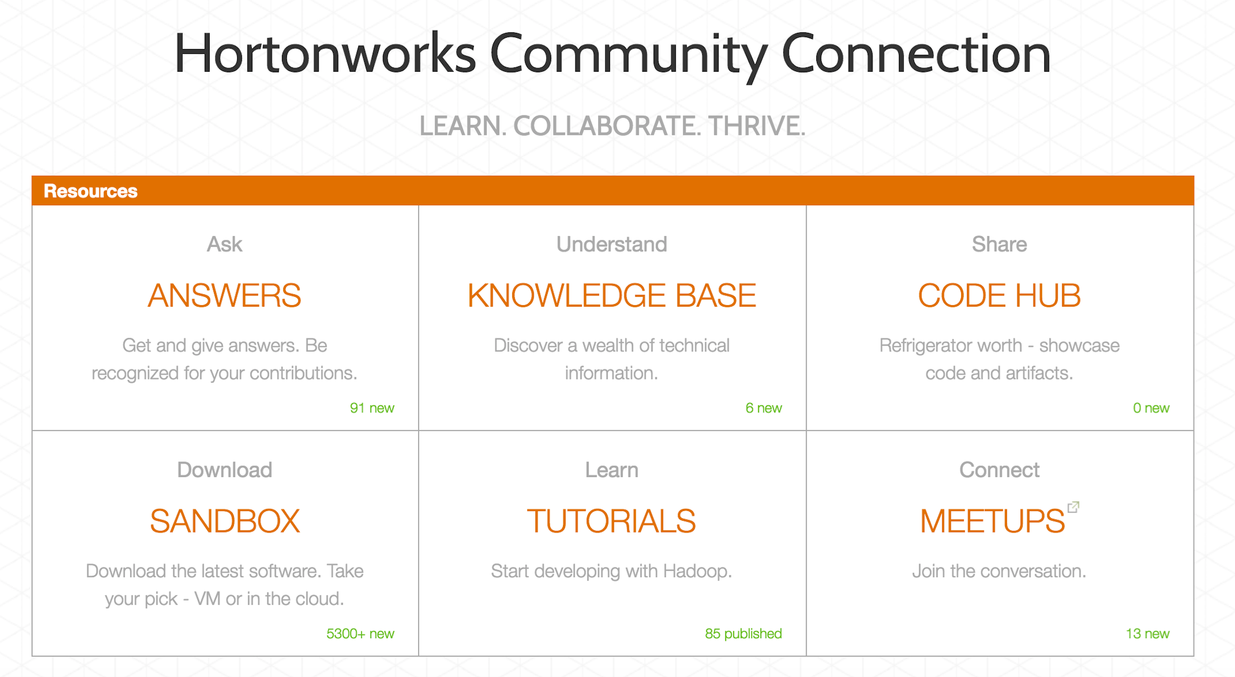
community.hortonworks.com

Slide 34
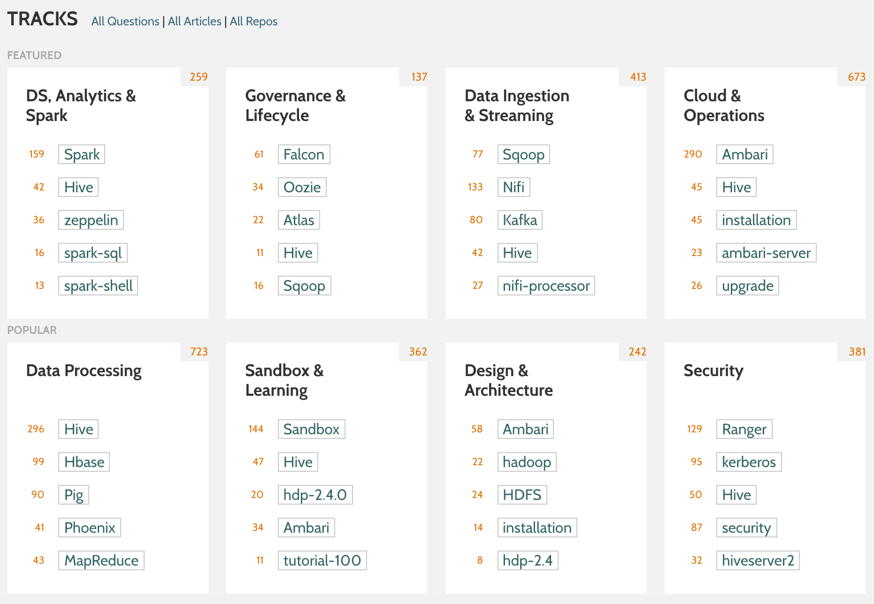
community.hortonworks.com

Slide 35
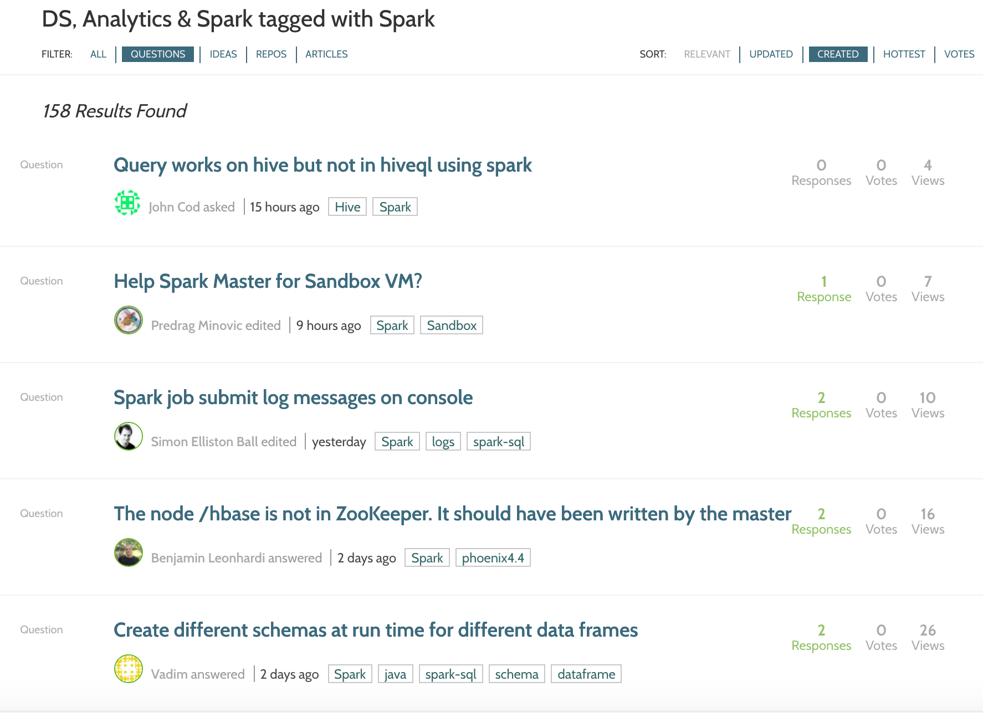
HCC DS, Analytics, and Spark Related Questions Sample

Slide 36
Lab Preview

Slide 37
Link to Tutorials with Lab Instructions
http://tinyurl.com/hwx-intro-to-spark

Slide 38
Thank you!
community.hortonworks.com

